Slide 1
Computer Vision: final assigment

Slide 2
Classification

Slide 3
Segmentation questions
Explain the difference with a classification setup, did you use skip connections?
We did not use skip connections due to computational constraints. This architecture takes a long time to compute, and its size is really big (minimum around 500MB).
The architecture chosen is encoder-decoder, which is more lightweight, better to use on Google Colab.
Did you pre-process/augment the data in any way?
Data was not pre-processed for the “from scratch” model.
For the TL model, the training segmented images were pre-processed so that each pixel values corresponded to its class. Results are here.
We decided not to augment the dataset because of computational constraints, it already takes a long time to train as is.
Visualize the training and validation learning curves (error over epoch). How did you establish that the training converged?
Attach image
Report the performance of your model on the test set (choose an appropriate metric for this task, e.g. Dice score is used a lot in medical image segmentation).
Report iou and dice score
Differences between TL and from scratch
Reconstruction is not as accurate.
Comparison of the number of trainable parameters:
TL model:
Total params: 65,819,349
Trainable params: 65,708,501
Non-trainable params: 110,848

Slide 4
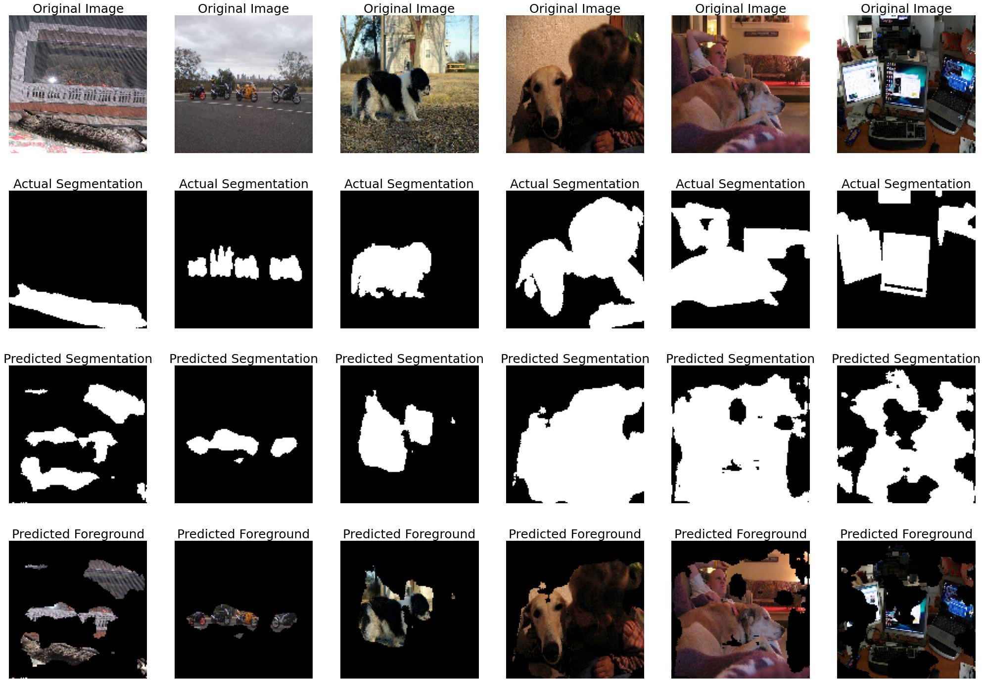
Transfer Learning from scratch results

Slide 5
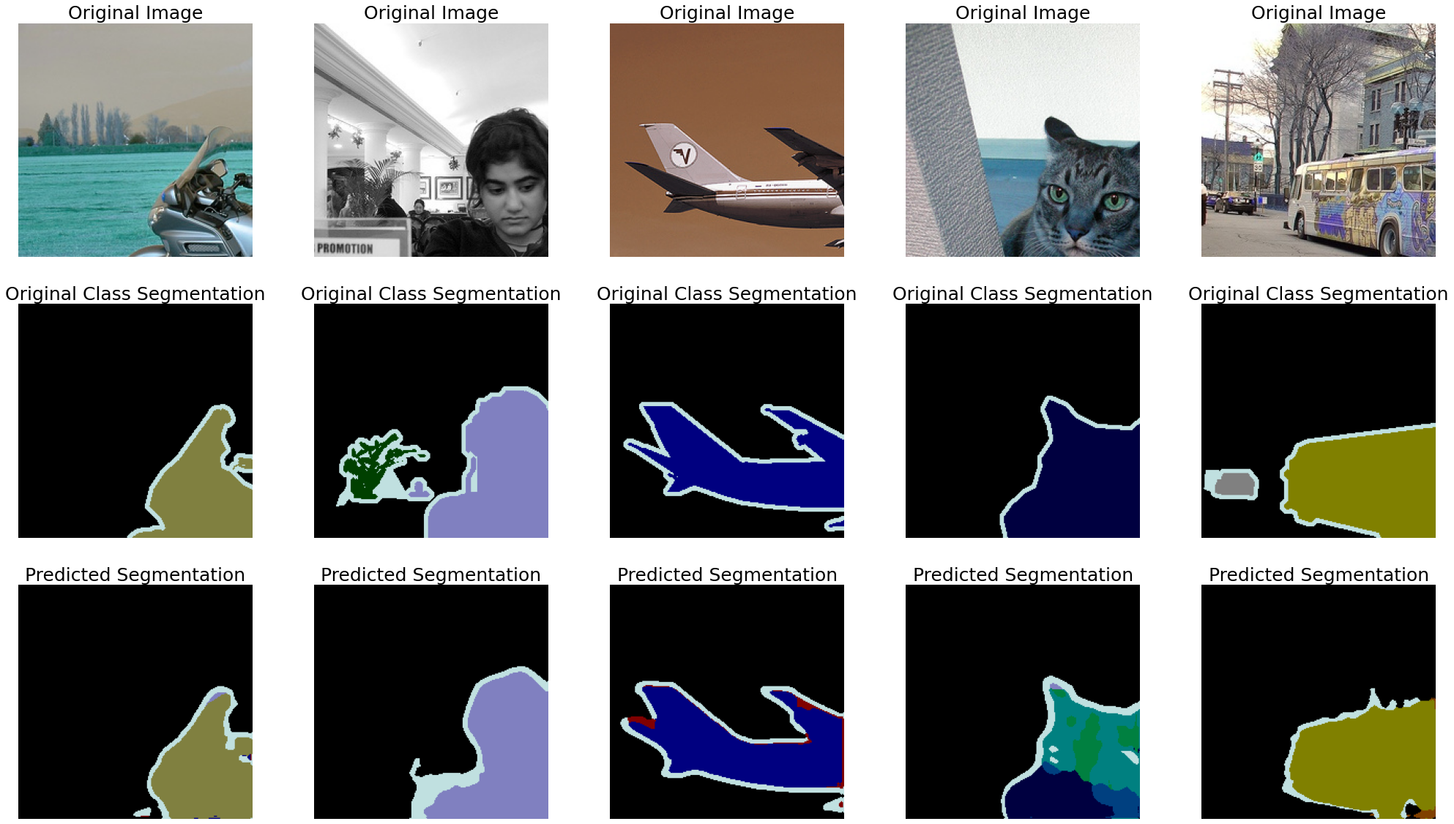
Transfer Learning segmentation results

Slide 6
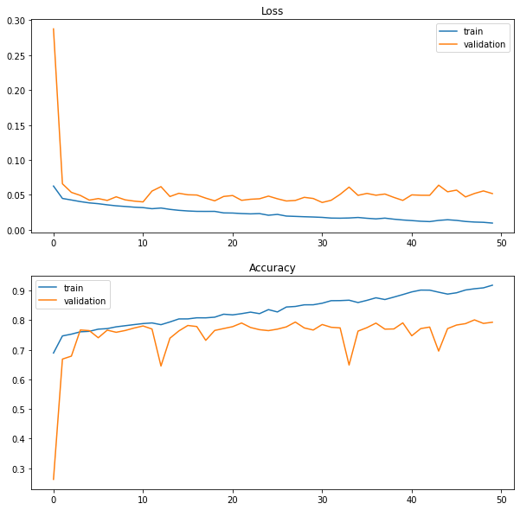
Transfer Learning segmentation learning curve

